Slide 1
SVM part 2
Kernel
Polynomial kernel
Radial basis function
Multiclass classification

Slide 2
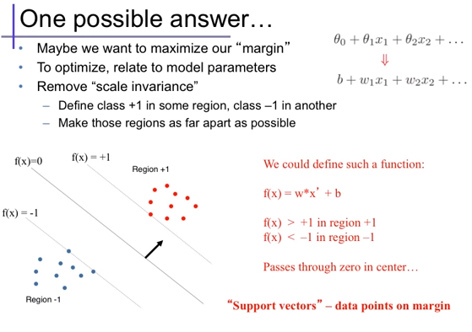
Maximum margin problem

Slide 3
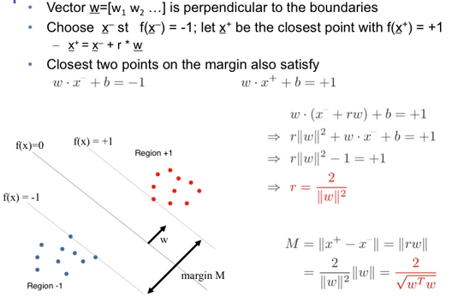
Computing margin width

Slide 4
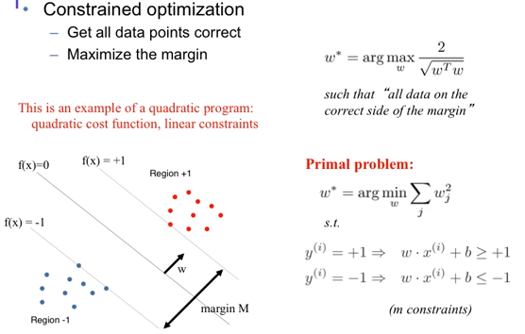
Maximum margin optimization

Slide 5
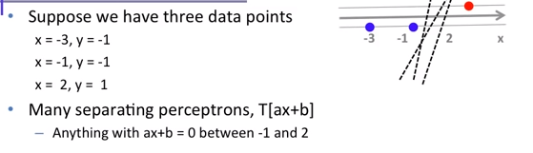
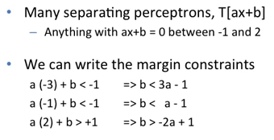
Maximum margin problem - example

Slide 6
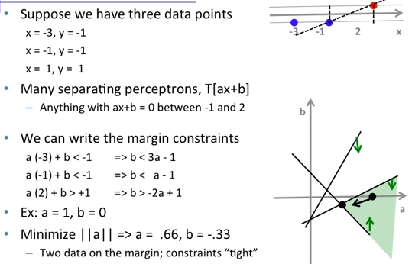
Maximum margin problem - example

Slide 7
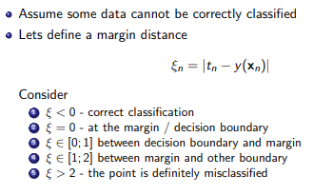
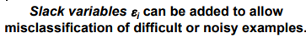
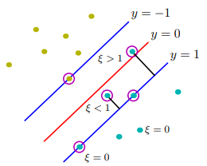
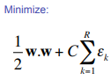
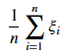
Soft margin
Average error =

Slide 8
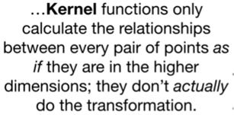
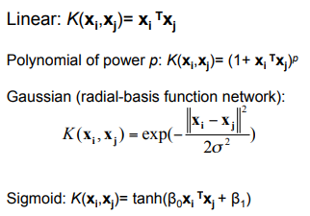
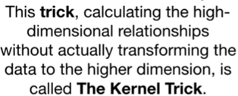
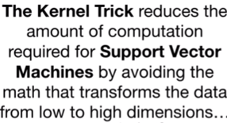
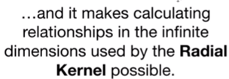
Kernel
Types of kernel

Slide 9
Kernel Trick
The kernel is a way of computing the dot product of two vectors x and y in some (very high dimensional) feature space
kernel functions are sometimes called “generalized dot product”

Slide 10
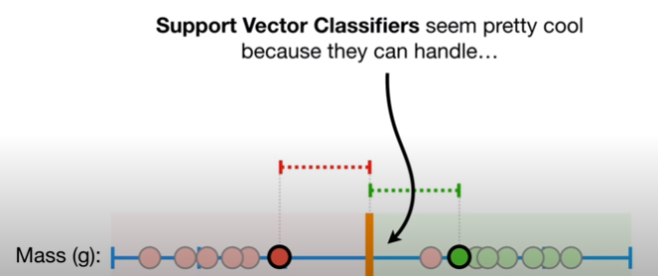
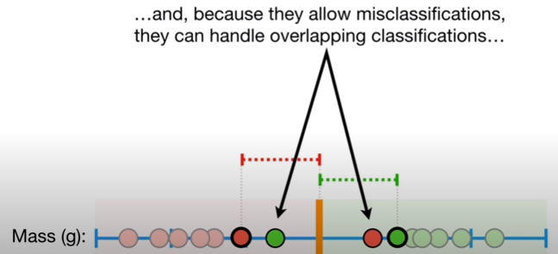
Polynomial kernel

Slide 11
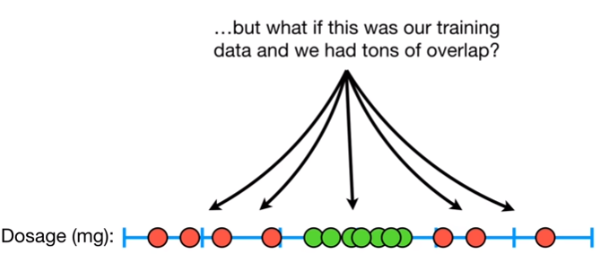

Slide 12
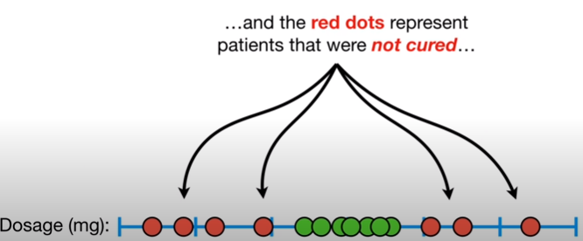
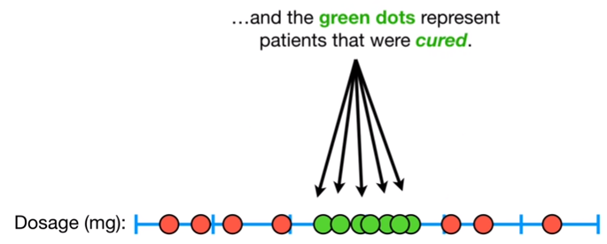

Slide 13
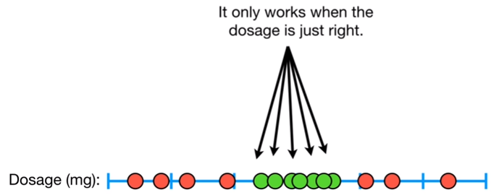

Slide 14
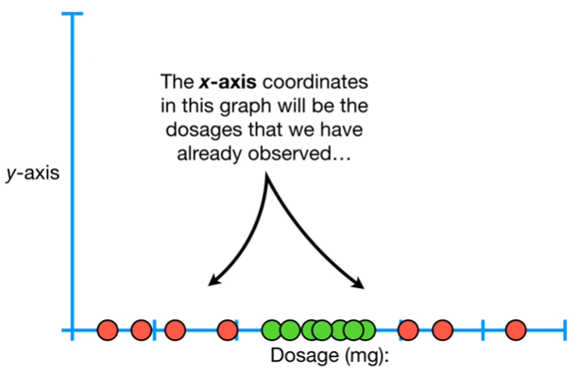
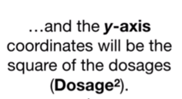

Slide 15
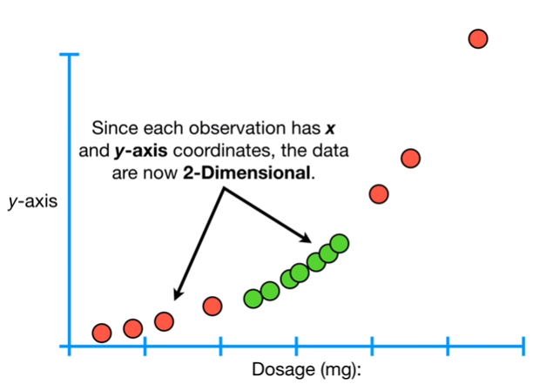

Slide 16
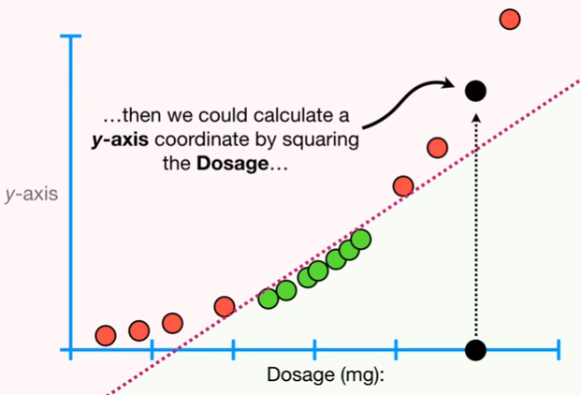
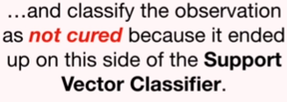

Slide 17
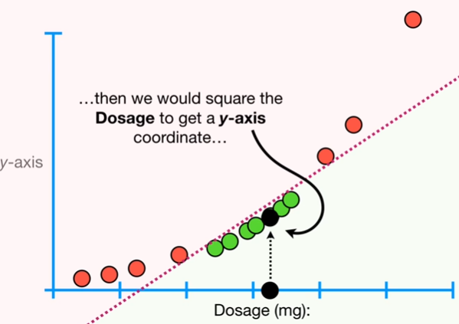
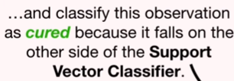

Slide 18
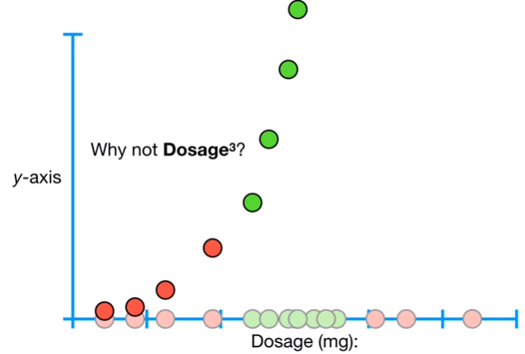
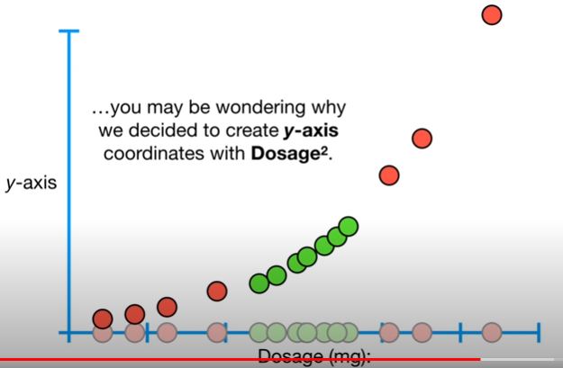
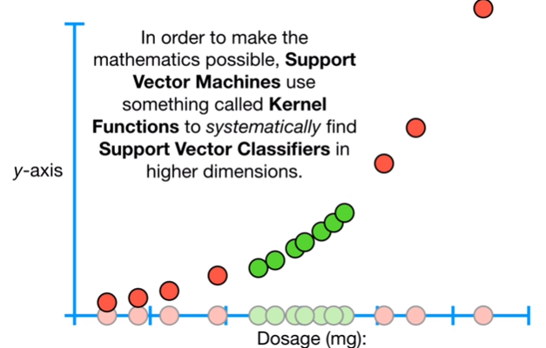
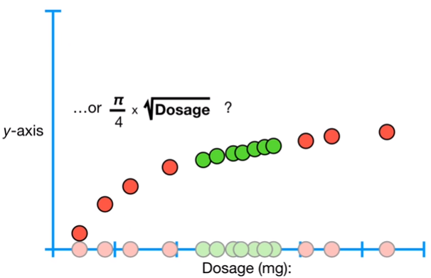

Slide 19
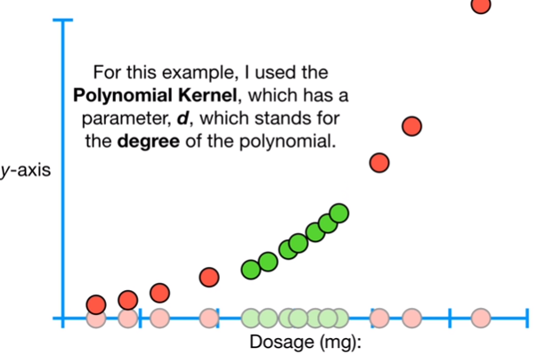

Slide 20
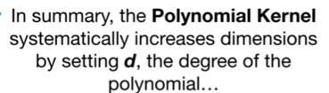
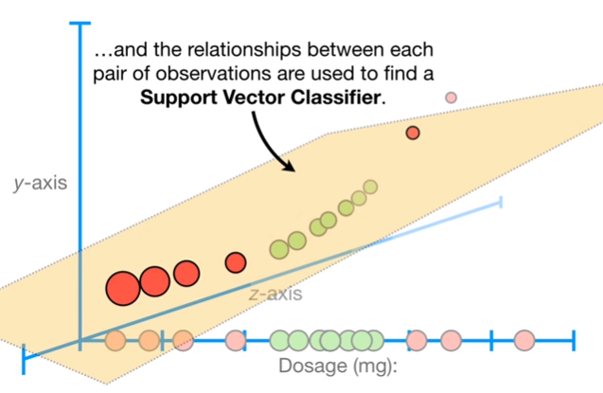

Slide 21
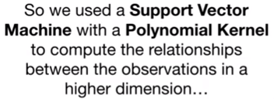
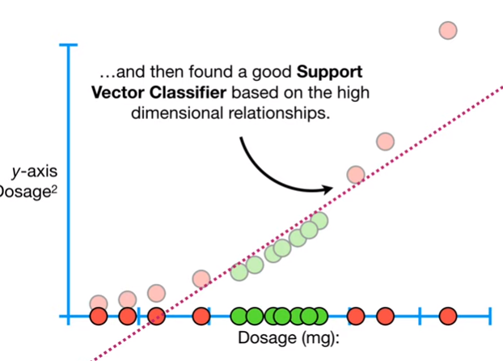
Polynomial kernel

Slide 22
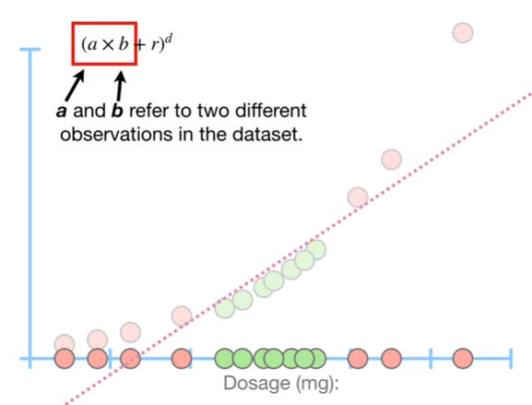
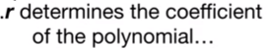
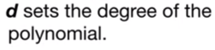

Polynomial kernel

Slide 23
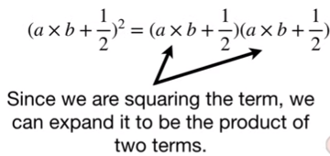
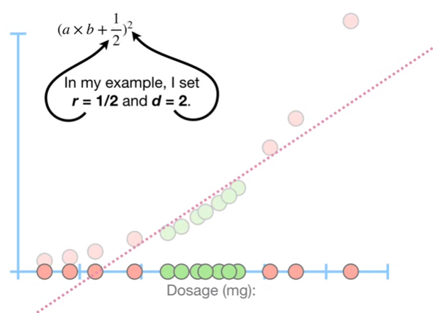

Slide 24
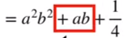
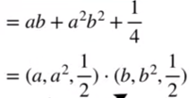
1, 3, 4, 5, 6

Slide 25
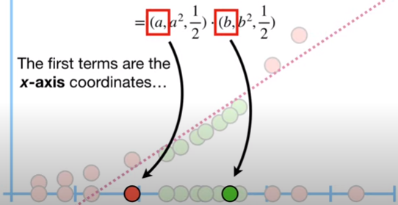
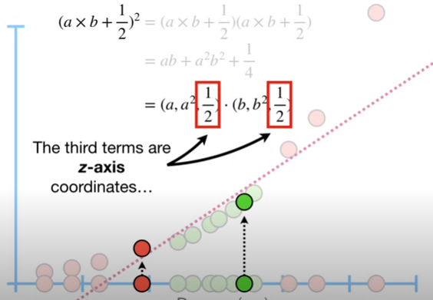
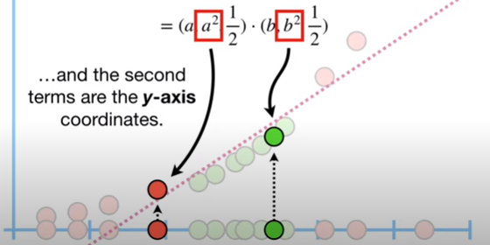
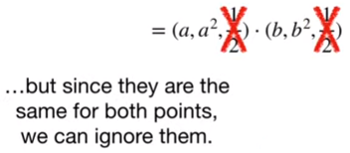

Slide 26
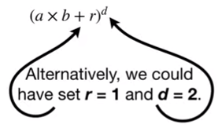







Slide 27


How does kernel works?

Slide 28



Radial Basis Function

Slide 29




Radial Basis Function Kernel

Slide 30





Working of Radial Basis Function Kernel

Slide 31




Radial Basis Function Kernel example

Slide 32


Radial Basis Function Kernel example

Slide 33


Multi – class classification
https://www.youtube.com/watch?v=6_YvpI-oDIs

Slide 34
One versus All
Training for each class with all the others serving as the non-class training samples
Typically training is skewed - too few positives compared to negatives
Better fit for the negatives The one vs all implies extra complexity in training ≈ K 2

Slide 35
Advantages of Support Vector Machine (SVM)
It is really effective in the higher dimension.
Effective when the number of features are more than training examples.
Best algorithm when classes are separable
The hyperplane is affected by only the support vectors thus outliers have less impact.
SVM is suited for extreme case binary classification.

Slide 36
Disadvantages of Support Vector Machine (SVM)
For larger dataset, it requires a large amount of time to process.
Does not perform well in case of overlapped classes.
Selecting, appropriately hyperparameters of the SVM that will allow for sufficient generalization performance.
Selecting the appropriate kernel function can be tricky.
Requires Feature Scaling
Longer training time

Slide 37
Few SVM Applications
- text (and hypertext) categorization
- image classification
- bioinformatics (Protein classification, Cancer classification)
- hand-written character recognition, etc.

